Slide 1
Food Magazine
Presentation

Slide 2
Group
Zobia Khalid 3355
Syeda Kainta 3256
Syeda Wajiha Zahra 3277
Sidra Rehman Afridi 3866
Kainat Kausar 3682

Slide 3
Features Used in Microsoft Word
Table of Content
Header 1 & Header 2
Insert Pictures (Picture Style & Size)
Wrap Text Behind Text & Square
Color Highlights
Text Color & Size
Page Color (Fill Effects)
Margins (Narrow)
Page Number (Bottom Of Page)
Bullets

Slide 4
Introduction
Craziness of Pakistani Cuisine
Food in Different Region of Pakistan
Foreigners Visits

Slide 5
Pakistani Food Specialty
Spiciness
Fully Cooked
Colored
Full Flavored and Rich in Taste
Full of Diversity and Culture

Slide 6
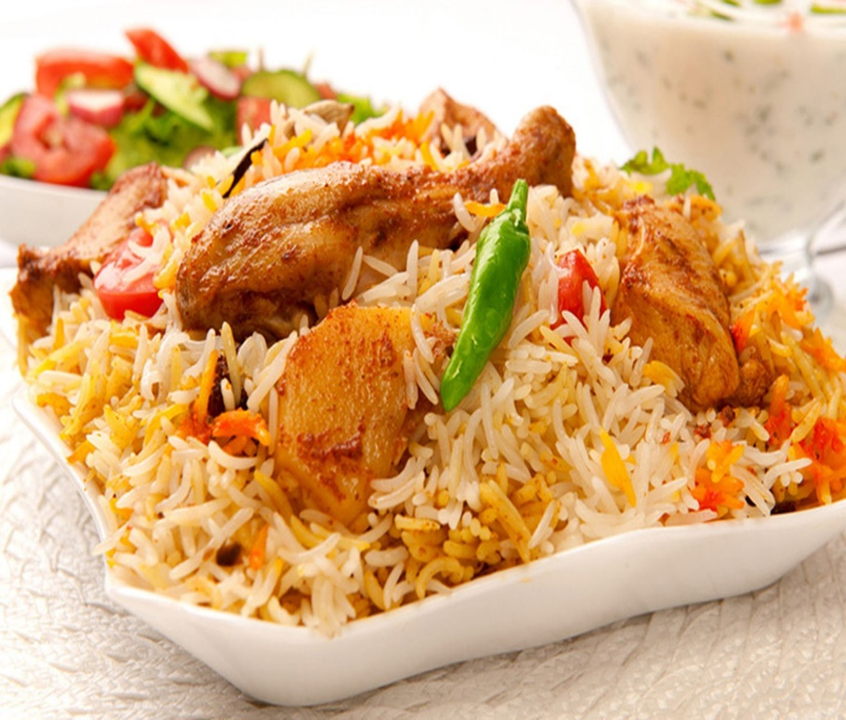
Biryani
Biryani is a mixture of delicious yellow rice and either chicken or beef.
And most loving Food of Pakistan.

Slide 7
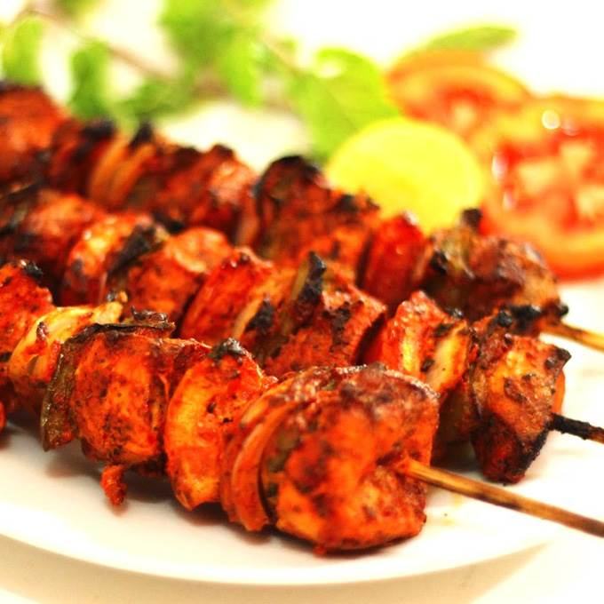
Chicken Tikka
Chicken tikka is one of the most popular foods in Pakistan, both for its taste and its nutritional value—that is if it is not accompanied by “naan.”
Sales at every Corner in Streets.

Slide 8
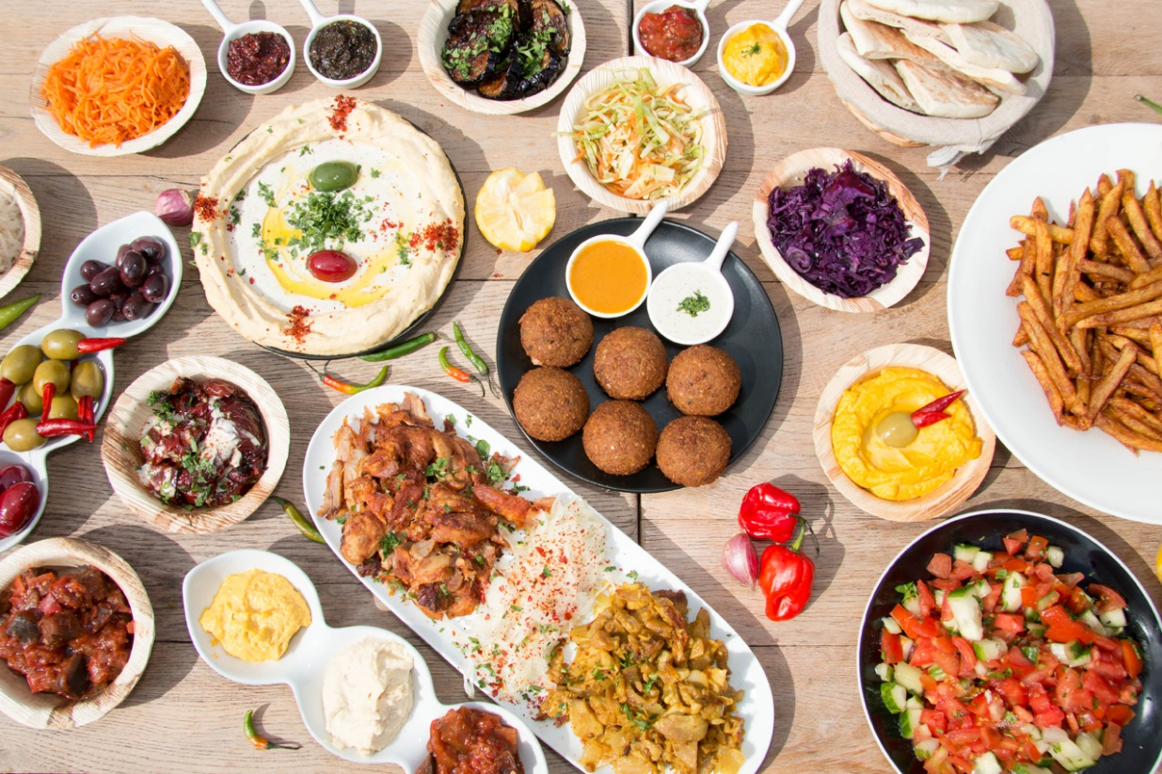
So Much Variety

Slide 9
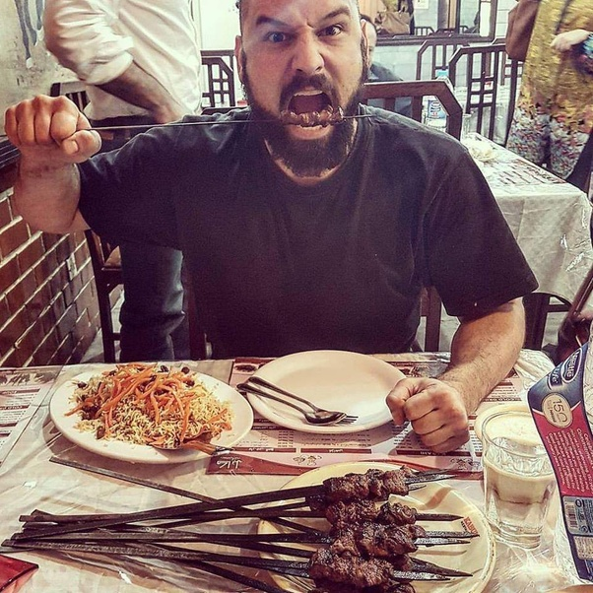
Foreigner Mesmerized by Pakistani Cuisine

Slide 10

Famous Food Vloggers visited Pakistan

